Slide 1
Multiplexing and de-multiplexing
Chapter-4

Slide 2
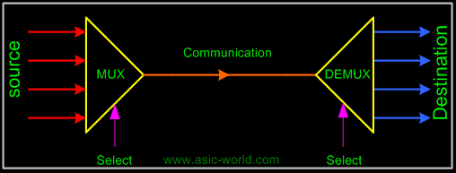
introduction
Multiplexing (or muxing) is a way of sending multiple signals or streams of information over a communications link at the same time in the form of a single, complex signal;
The receiver recovers the separate signals, a process called DE multiplexing (or demuxing).
Multiplexing and demultiplexing are performed by a Multiplexer (also called a MUX) which usually has both capabilities.

Slide 3
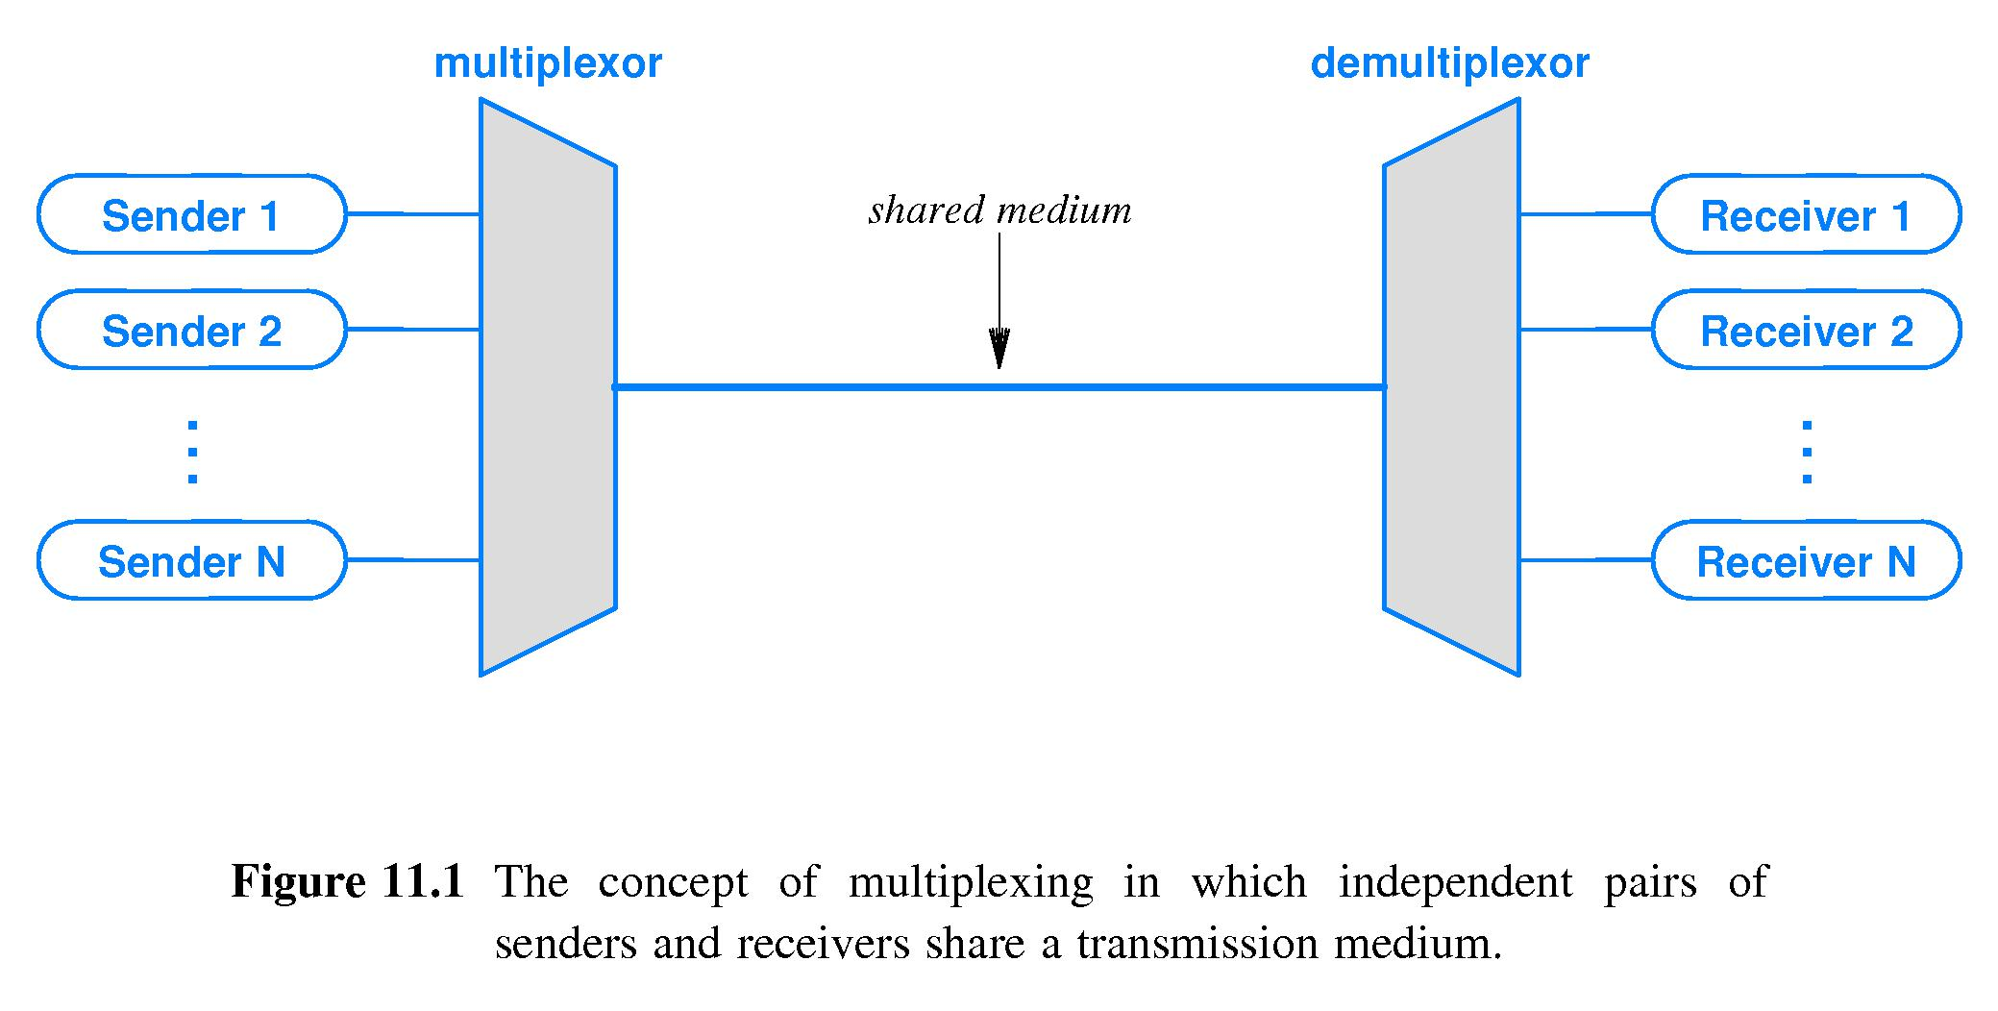

Slide 4
MUX
Multiplexer
Multiplexing
Analog
Digital
De-Multiplexing
FDM
WDM
TDM
CDM
Synchronous
TDM
Asynchronous
TDM

Slide 5
What is a Multiplexing ?
Multiplexing is a technique that enable broadband media to support multiple data channels.
Multiplexing can enable :
Mainframe , LAN , Voice, Video conferencing , other data type.
Large amounts of data must be transmitted through low capacity channels.
Multiplexing techniques can divide the original data stream into several lower-bandwidth channels, each of which can be transmitted though a lower-capacity medium.

Slide 6
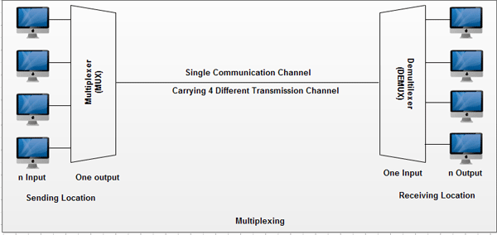

Slide 7
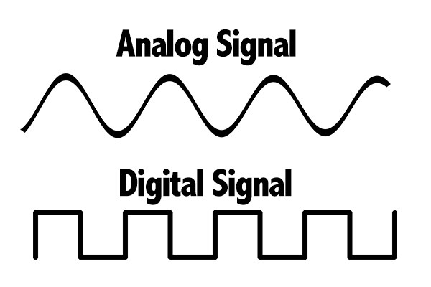
Analog & Digital signal
analog is a continuous electrical signal, whereas digital is a non-continuous electrical signal.
Analog waves are smooth and continuous, digital waves are stepping, square, and discrete.

Slide 8
Types of multiplexing
FDM
WDM
TDM
CDM

Slide 9
MUX
Multiplexing
Analog
Digital
De-Multiplexing
FDM
WDM
TDM
CDM
Synchronous
TDM
Asynchronous
TDM

Slide 10
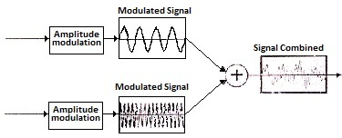
FDM (Frequency division multiplexing)
Frequency Division Multiplexing (FDM) is a networking technique in which multiple data signals are combined for simultaneous transmission via a shared.
Frequency Division Multiplexing (FDM) is a scheme in which numerous signals are combined for transmission on a single communications line or channel.
FDM uses a carrier signal at a discrete frequency for each data stream and then combines many modulated signals.

Slide 11
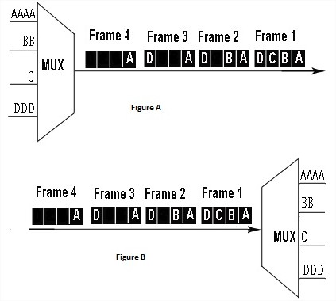
TDM (Time division multiplexing)
Time-division multiplexing (TDM) is a method of putting multiple data streams in a single signal by separating.
the signal into many segments, each having a very short duration. Each individual data stream is reassembled at the receiving end based on the timing.

Slide 12
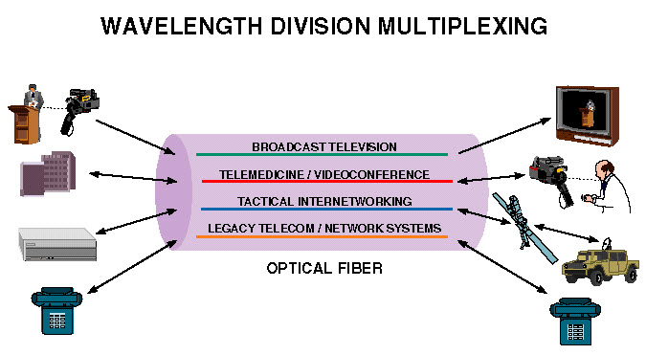
WDM (Wavelength division multiplexing)
Wavelength-division multiplexing (WDM) is a method of combining multiple signals on laser beams at various infrared (IR) wavelengths for transmission along fiber optic media. Each laser is modulated by an independent set of signals.

Slide 13
(CDM)Code division multiplexing
Code Division Multiplexing assigns each channel its own code to make them separate from each other. These unique underlying codes.
Code division multiplexing (CDM) is a networking technique in which multiple data signals are combined for simultaneous transmission over a common frequency band.

Slide 14
